Slide 1
Distance Education October 4, 2018

Slide 2
Online Education
Learning Management System used for online education is Blackboard
Offer 23 programs online
Students taking at least one online course:
Fall 2018 - 400 students
DCB Headcount for fall 2018 – 996 students
40% of students are taking one online class
Offer around 130 classes online

Slide 3
Online Growth

Slide 4
Statistics
92% of fall 2018 students have a North Dakota Address
We provide online classes to students located in 93 different cities in North Dakota – many of which are rural
The remaining online students are located in 21 different states

Slide 5
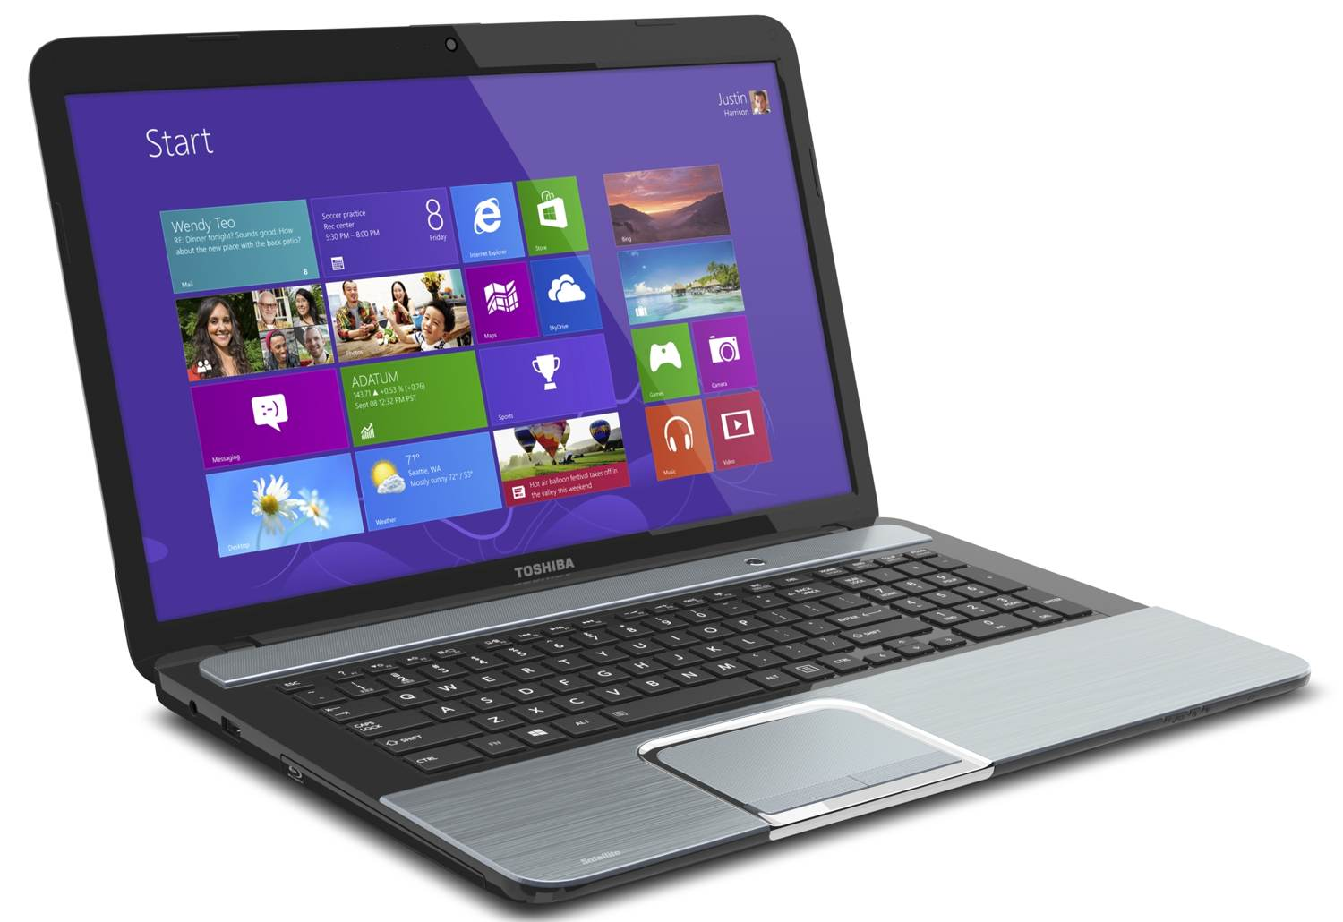
Online Programs
Accounting Technician
Admin. Assistant
Advertising and Marketing
Bookkeeping
Caregiver Services
College Studies Certificate
Liberal Arts (AA and AS)
Medical Programs (Admin. Assist., Coding, Assistant)
Paraprofessional Programs (K-12, Early Childhood)
Photography
Reception Services
Recreation Management
Urban Forest Management

Slide 6
Dual Credit/Early Entry
High school students have the opportunity to earn college credit while in high school
Students who meet the requirements can take certain courses for both high school and college credit through Dakota College at Bottineau

Slide 7
Who is Eligible?
High school sophomores, juniors, and seniors may enroll in dual credit classes
Students must get written permission from their parents and high school administrator
Most schools require a GPA of 3.0

Slide 8
Benefits
Complete college requirements while still in high school
Experience what college coursework is like
Pay reduced tuition for dual credit classes - $132.41 per credit
General Education courses transfer to NDUS colleges
Bank of ND Scholarship – cover tuition, books, application fee for two classes per academic year

Slide 9
Delivery Methods
IVN
Face-to-face instruction in high schools where qualified instructors teach dual credit courses
Online courses

Slide 10
Early Entry – IVN Spring 2018
Campus | Total Classes Sent | Receive Sites
 |  | High Schools | NDUS Campuses | Other | Desktop Video⬇ | Total Enrollment
BSC | 6 | 21 | 0 | 0 | 0 | 110
DCB | 14 | 41 | 0 | 0 | 1 | 170
LRSC | 5 | 8 | 2 | 0 | 4 | 69
MaSU | 4 | 22 | 0 | 0 | 0 | 124
NDSCS | 5 | 11 | 0 | 0 | 0 | 93
WSC | 5 | 7 | 1 | 0 | 0 | 86
TOTALS: | 39 | 110 | 3 | 0 | 5 | 652
*NDUS IVN Spring 2018 Report

Slide 11
Fall 2018 Statistics
40 High Schools in ND are taking dual credit with DCB
303 students taking dual credit with DCB (467 registrations)
27% of dual credit registrations are online
33% of dual credit registrations are at the High School
39% of dual credit registrations are IVN

Slide 12
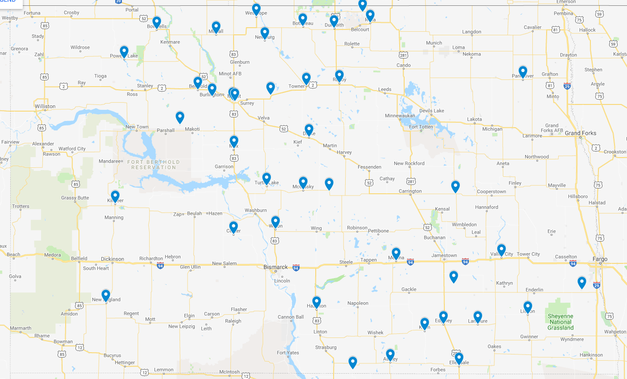

Slide 13
Dual Credit Growth

Slide 14
LEAP (Leading to Education and Advanced Preparation) Program
Unique to DCB
New for Fall 2017
Allows high school students to earn Certificate of College Studies degree alongside their High School Diploma
General Education courses – 24 credits

Slide 15
LEAP Program
Saves students time and money
Discounted tuition rate
Bank of ND Scholarship
Saves essentially one or two semesters of college
Work with a college advisor
Opportunity to walk at DCB’s graduation
DCB will come and present at their high school graduation

Slide 16
LEAP Statistics
Graduated 7 students in May, 2018 (MLS and Midkota)
Over 20 students enrolled in LEAP program this semester
Have 3 students working on A.S. degrees in high school

Slide 17
Thank you!
For more information about Distance Education at DCB, please contact Kayla O’Toole at 701-228-5479 or at kayla.otoole@dakotacollege.edu

