Slide 1



Disability Support Services
Ensuring equal access for students with disabilities.

Slide 2

Legal Information
FERPA
The law defines a person as disabled if the individual:
  Has a physical or mental impairment
  Which substantially limits one or more major life activities
  And has a record of such an impairment or is regarded as having such an impairment
HIPAA
Americans with Disabilities Act (ADA)
[Amended in 2008]
Section 504 of the Rehabilitation Act of 1973

Slide 3
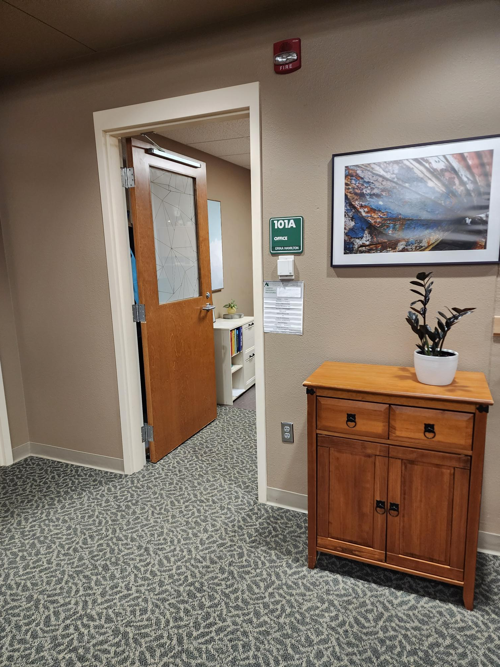
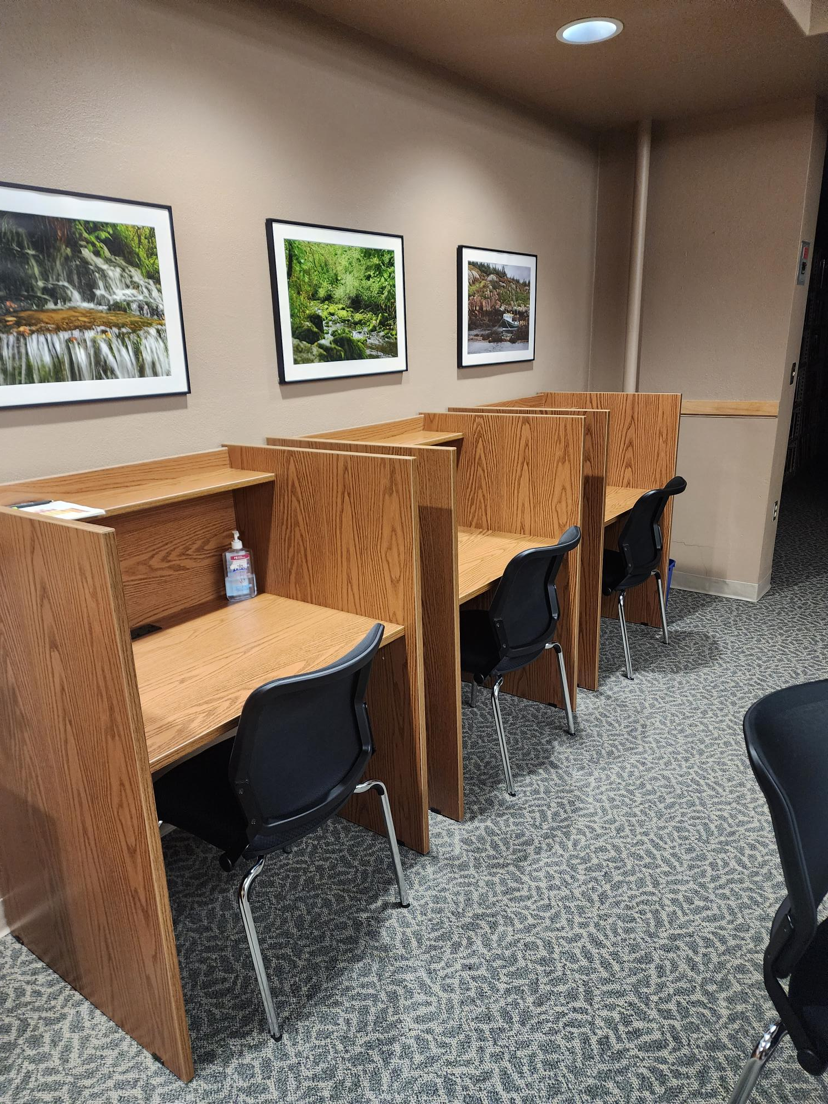
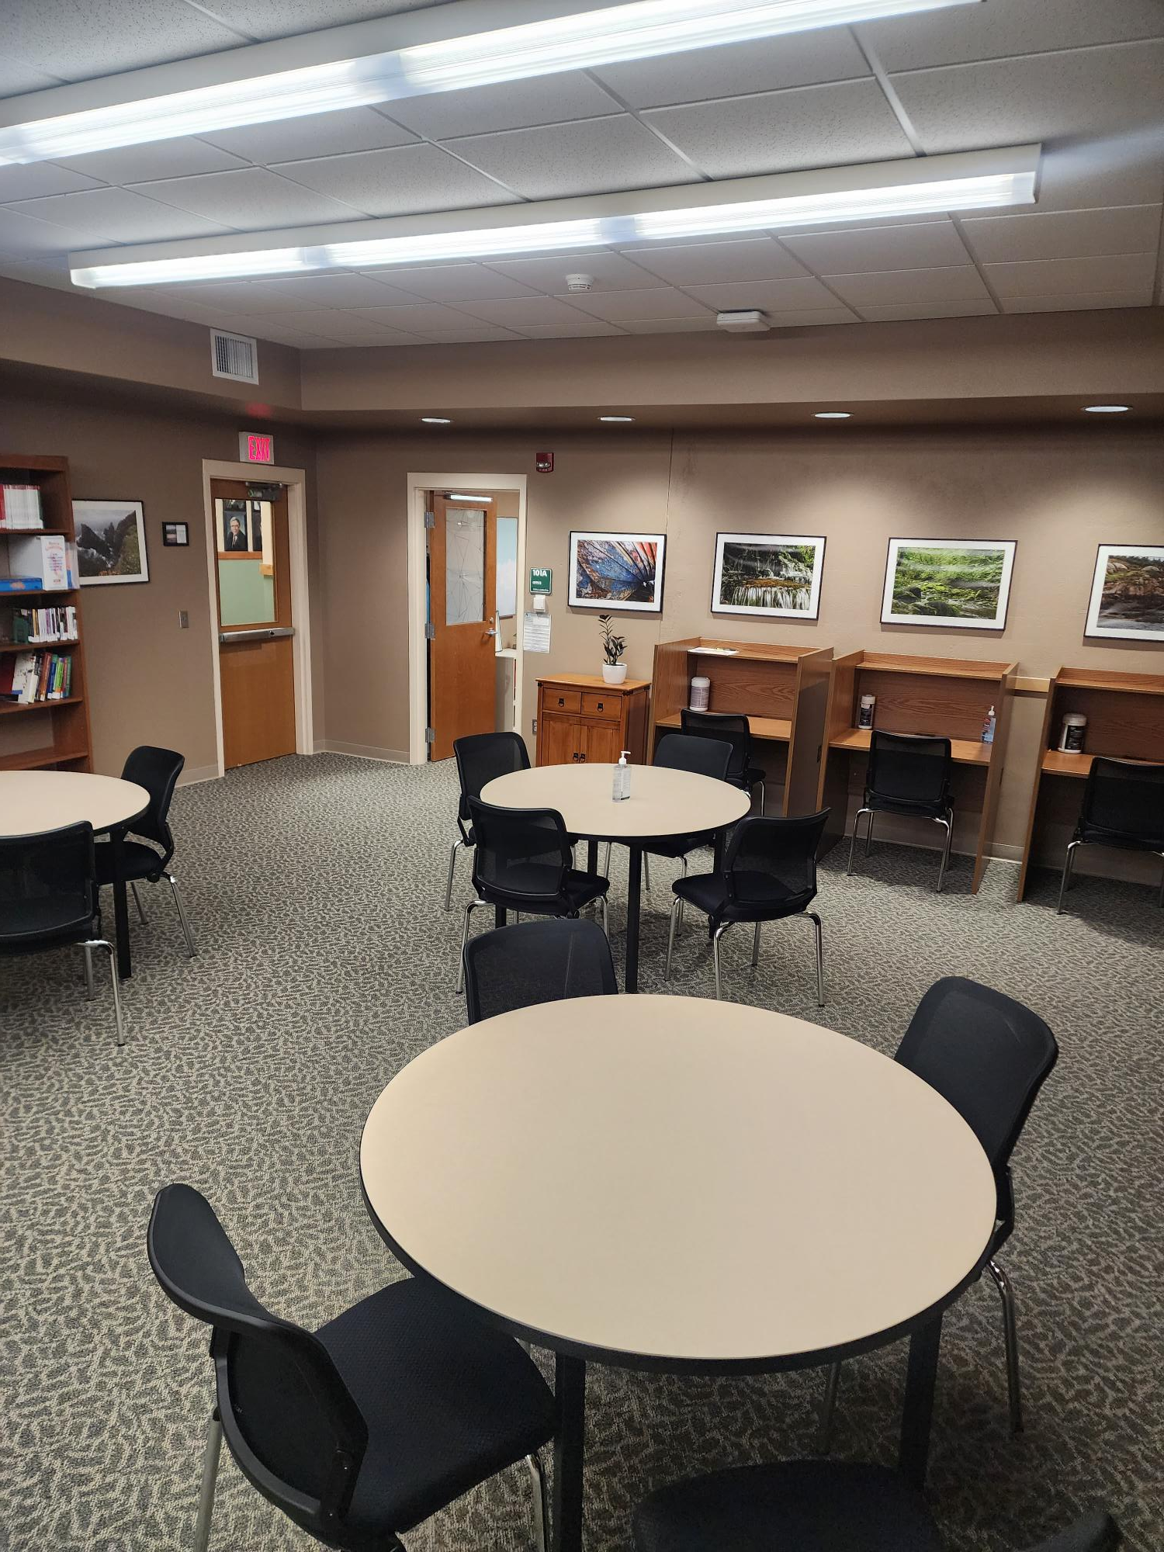

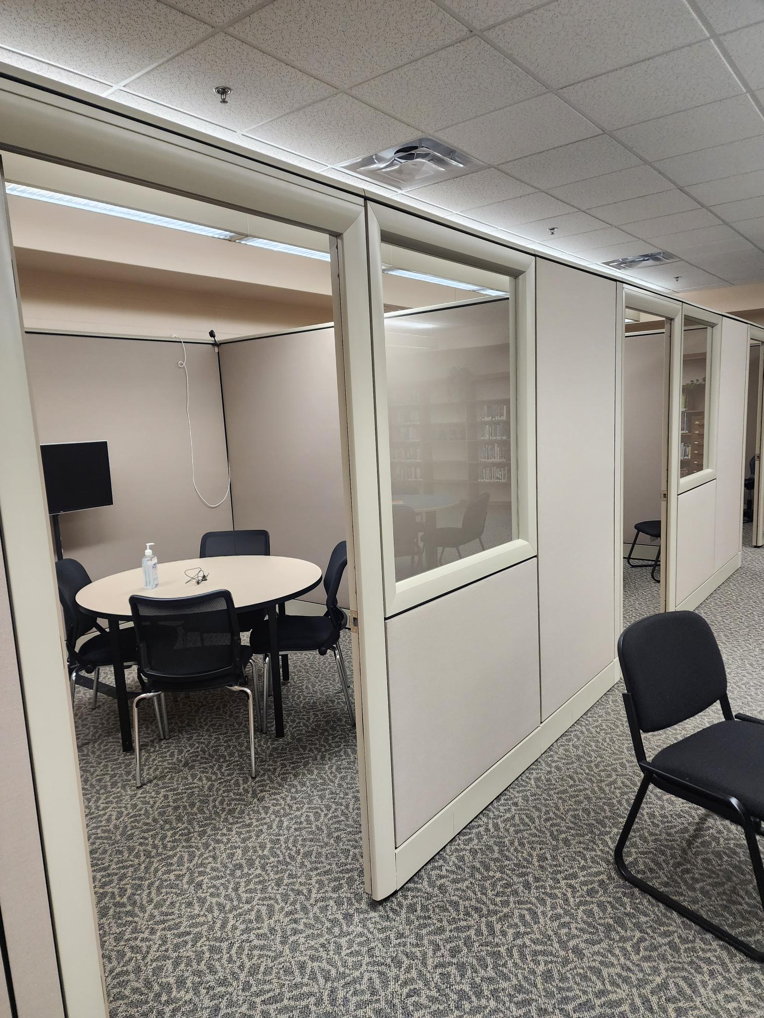
DCB Disability Support Services
Office located in library Study Carrels Table Space Study Rooms

Slide 4
Frequent Types of Disabilities Registered with DSS
Common Types of Accommodations
Attention Deficit/Hyperactivity (ADHD)
Mental Health Disorders (other than ADHD)
Learning Disabilities
Autism Spectrum Disorders
Extended time on Exams
Testing in a Reduced Distraction Environment
Access to Calculators
Access to notes and PowerPoints

Slide 5
Our Process
Apply
Contact with Disability Support
Submit Documentation of Disability
Meet
Documentation is Reviewed
We can discuss and set up helpful accommodations
Inform
With your consent, only current instructors are informed about expected accommodations
Make sure to notify me every semester/ whenever classes change

Slide 6

Disability Support Services
Erika Hamilton, Ed.S.
Erika.Hamilton@dakotacollege.edu
701-228-5425
Office in the library, 101A

